Slide 1
Benzene Concentration Prediction using Machine Learning
A Data-Driven Approach using Random Forest Regressor
Presented by:
Jibina M V
Anupama

Slide 2
Introduction
Objective: Predict Benzene (C6H6) concentration using environmental data
Dataset: Air Quality UCI Dataset
Tools: Python, Scikit-learn, Jupyter, Matplotlib, Seaborn

Slide 3
Dataset Overview
Features: T, RH, AH, CO(GT), NOx(GT), NO2(GT)
Target: C6H6(GT) - Benzene Concentration
File: AirQualityUCI.xlsx

Slide 4
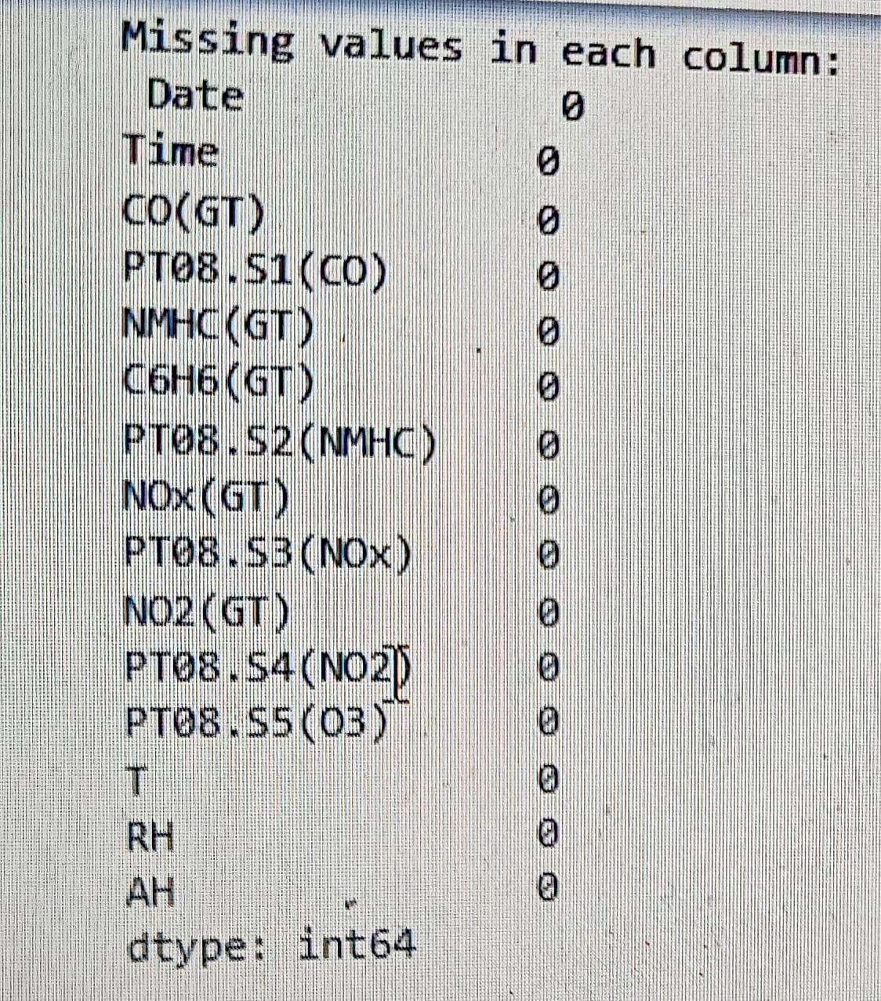
Data Preprocessing
Dropped missing values
Selected key features and target
Split data into training (80%) and test (20%) sets

Slide 5
EXPLORATORY DATA ANALYSIS (EDA)
Boxplot highlights outliers in benzene levels.
Histogram shows skewness or normality of benzene concentration.
Correlation heatmap shows which sensors or weather variables relate most to benzene levels.
RESIDUAL DISTRIBUTION The residual distribution for the benzene prediction model appears approximately normal and centered around zero.

Slide 6
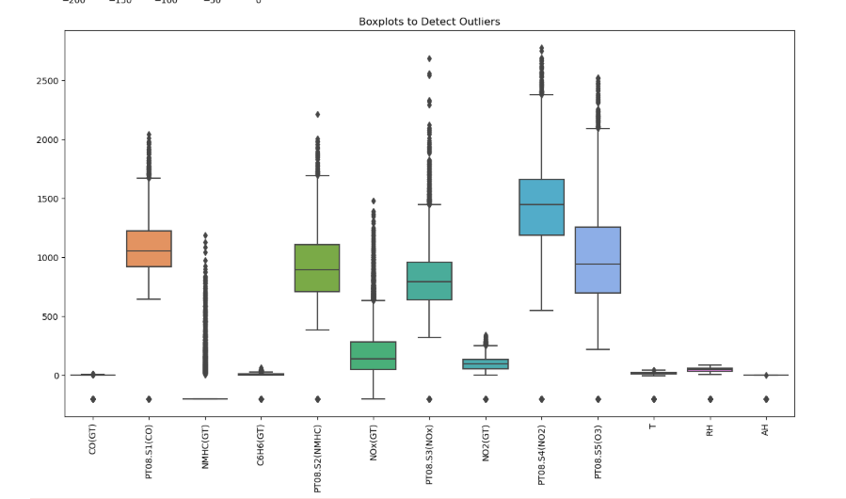
BOX PLOT

Slide 7
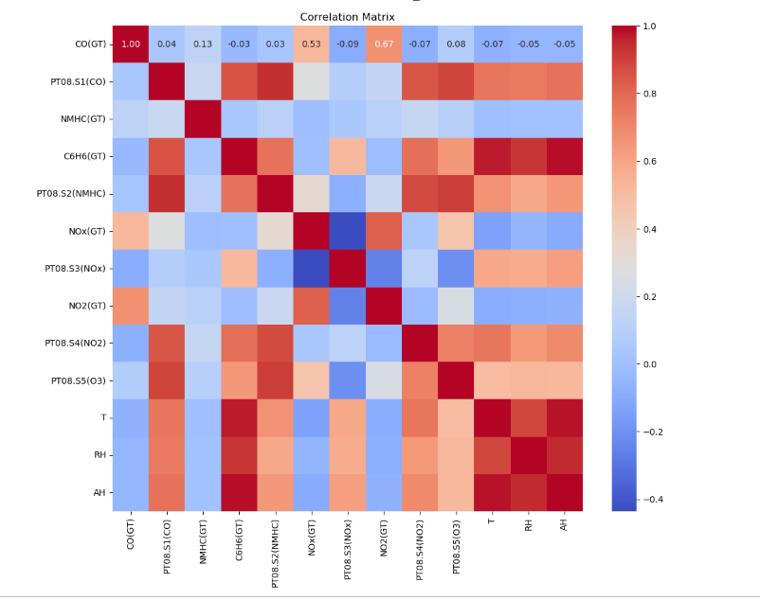
CORRELATION HEAT MAP

Slide 8
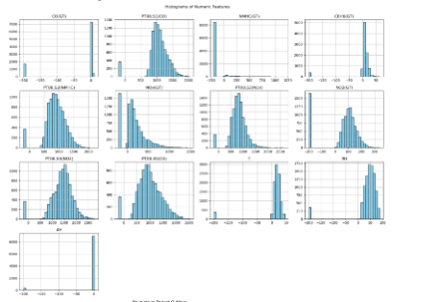
HISTOGRAM

Slide 9
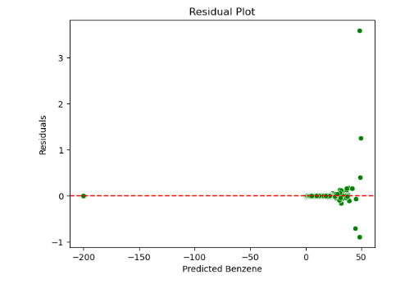
Residuals Distribution
Include histogram image: Residuals Distribution
Interpretation: Errors are mostly centered around 0, which is ideal

Slide 10
Model Used
Algorithm: Random Forest Regressor
Parameters: n_estimators=100, random_state=42
Library: Scikit-learn

Slide 11
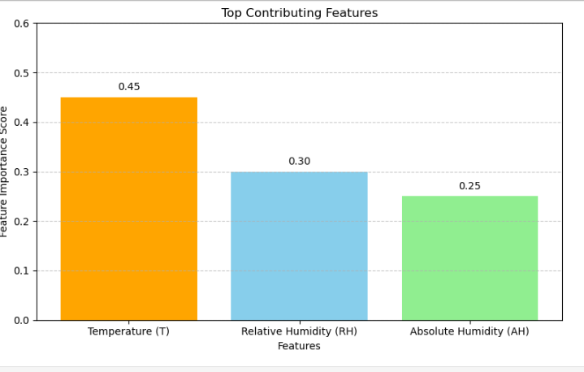
Feature Importance - Random Forest
Bar plot image showing top contributing features
Most important: Temperature (T), Relative Humidity (RH), and Absolute Humidity (AH)

Slide 12
Performance Metrics
Root Mean Squared Error (RMSE): 3.182
R² Score: 0.994
Model shows excellent prediction accuracy

Slide 13
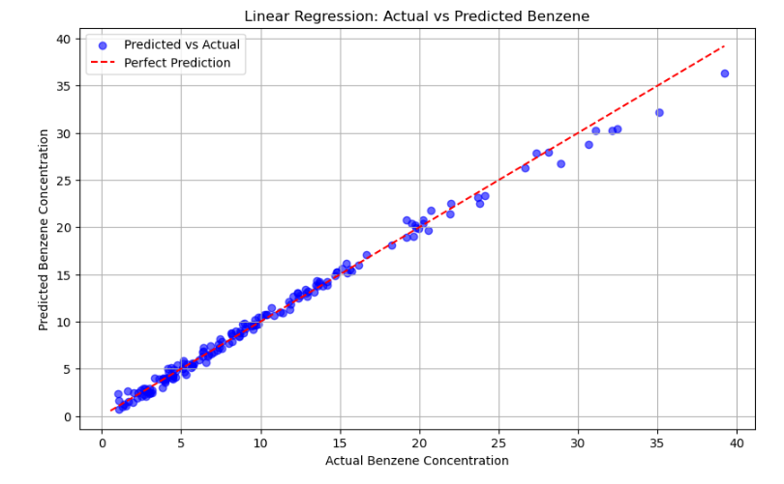
Actual vs Predicted Benzene Concentration
Include the scatter plot image: Actual vs Predicted Benzene Concentration
Interpretation: Most points lie near the identity line, indicating high accuracy.

Slide 14
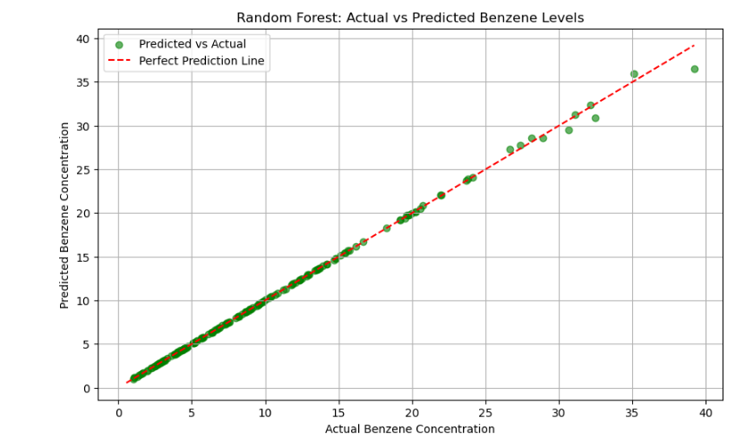
Random forest regression

Slide 15
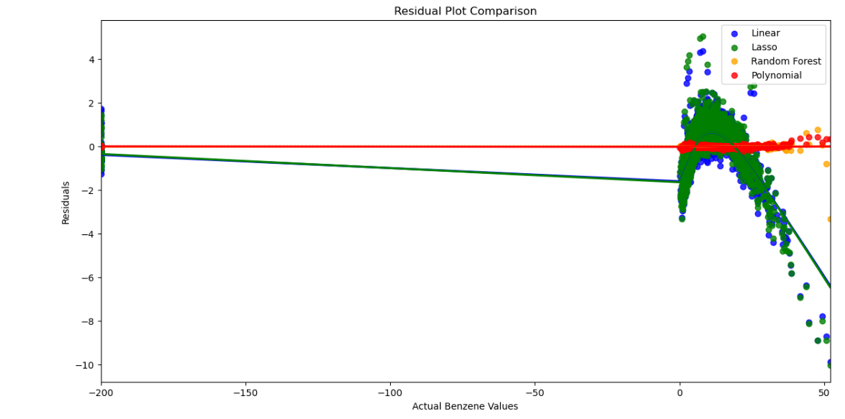
Regression Model-EDA

Slide 16
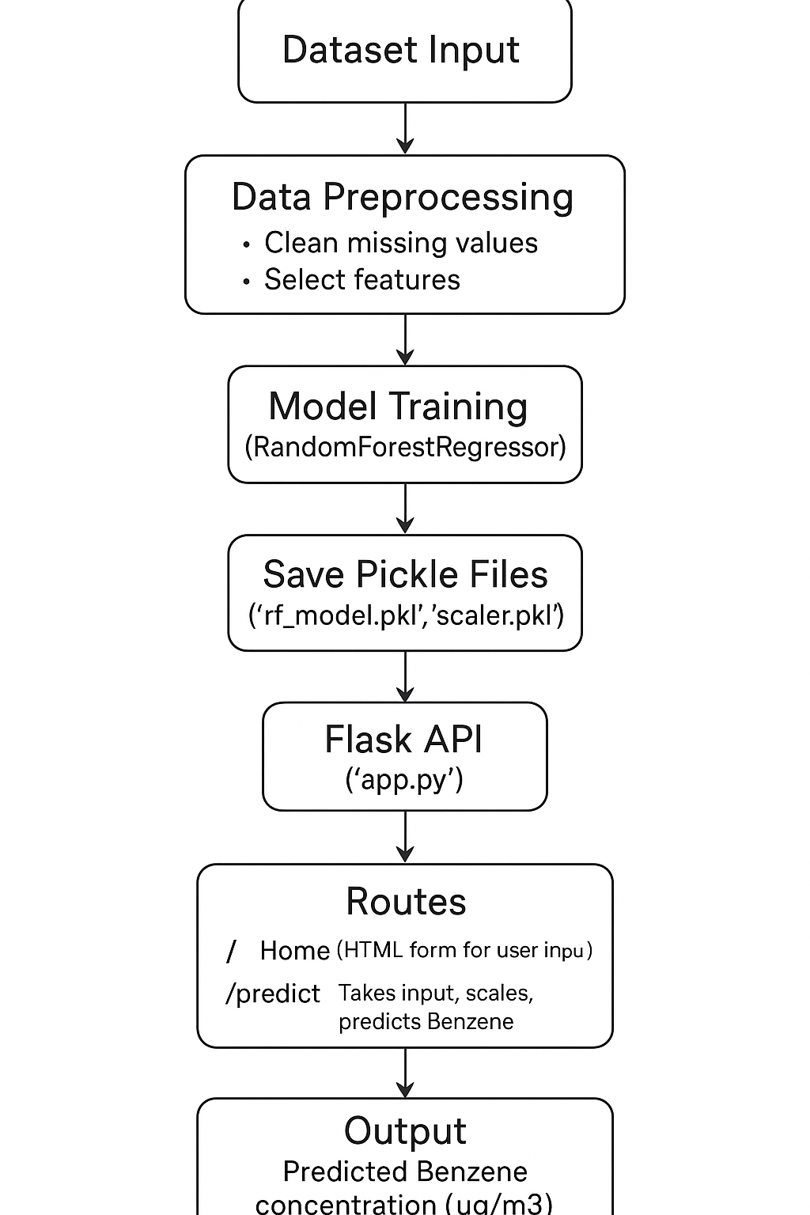
Flowchart-Benzene prediction

Slide 17
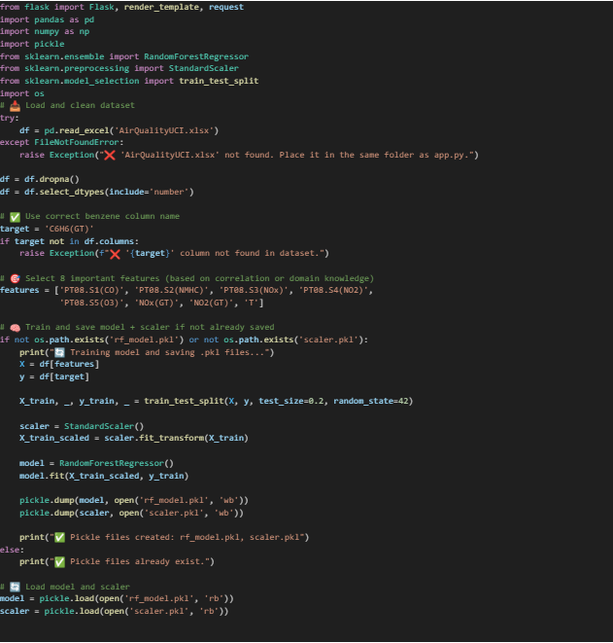
APPLICATION DEPLOYMENT – HTML App.py

Slide 18
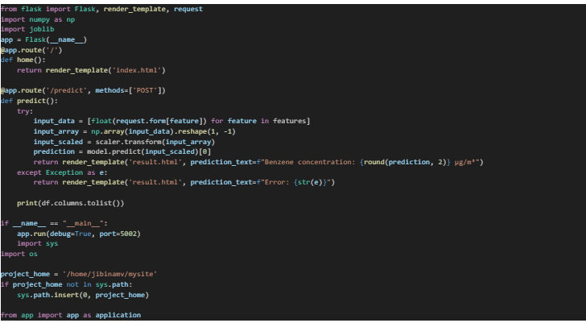
Web.py

Slide 19
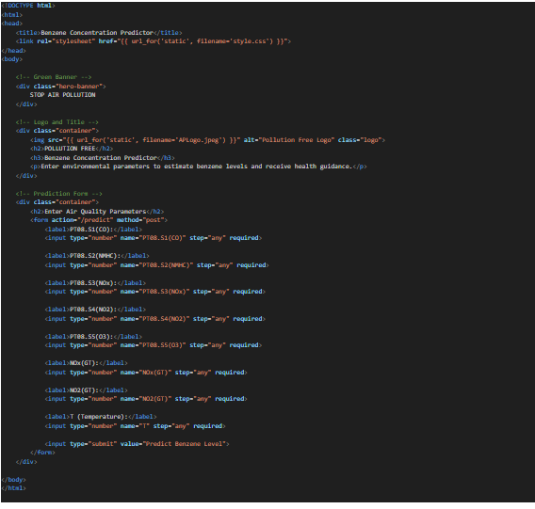
Index.html

Slide 20
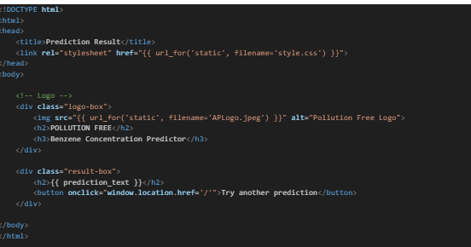
Result.html

Slide 21

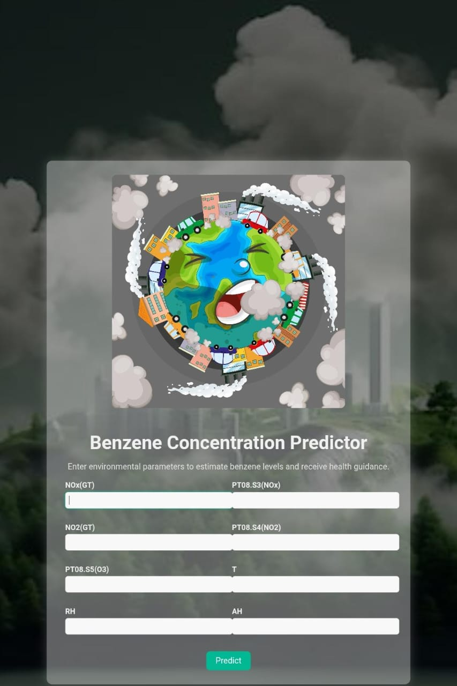
Prediction Result

Slide 22
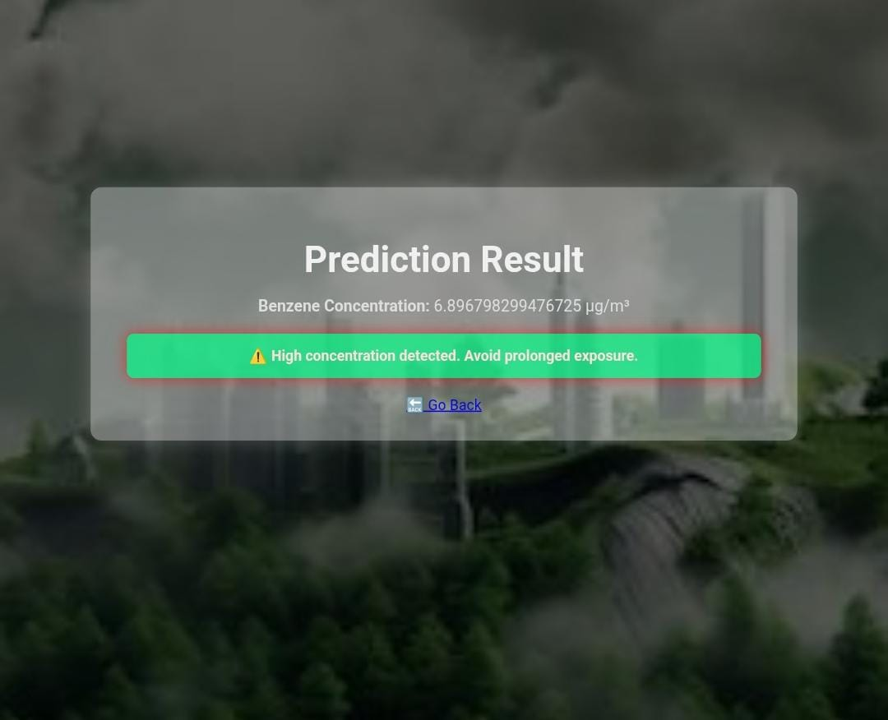
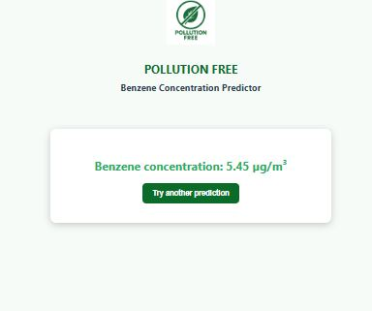
Prediction result

Slide 23
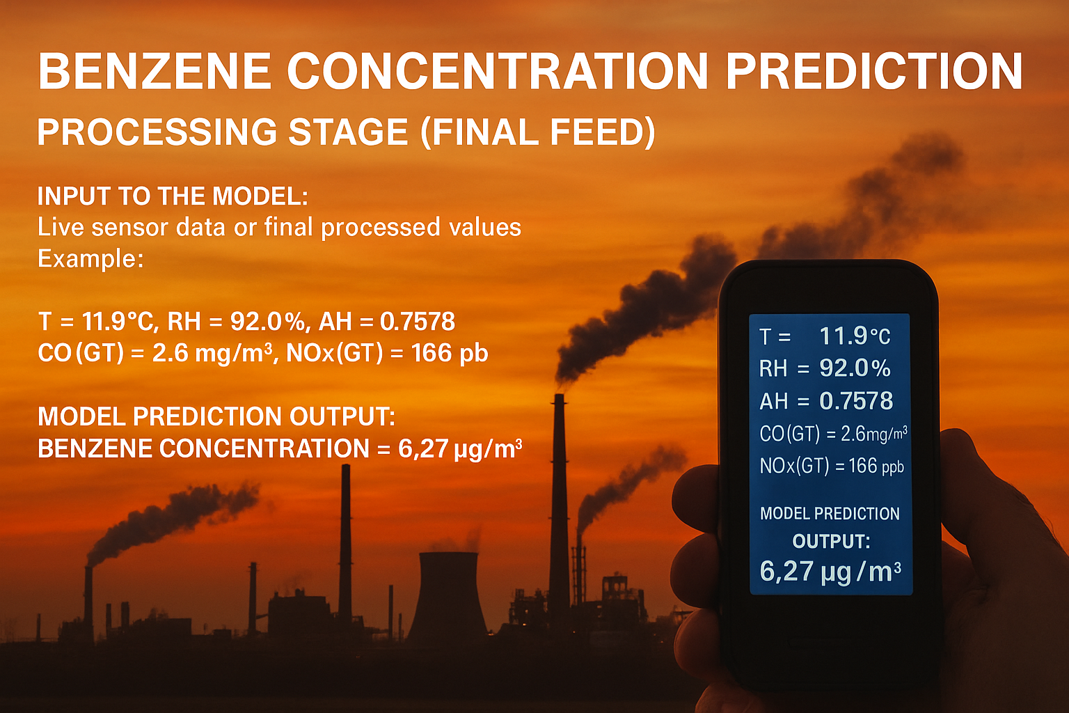

Slide 24
Conclusion
Model achieved high accuracy in predicting Benzene levels.
Humidity and temperature are major influencing features.
Random Forest is well-suited for this regression task.

